Slide 1
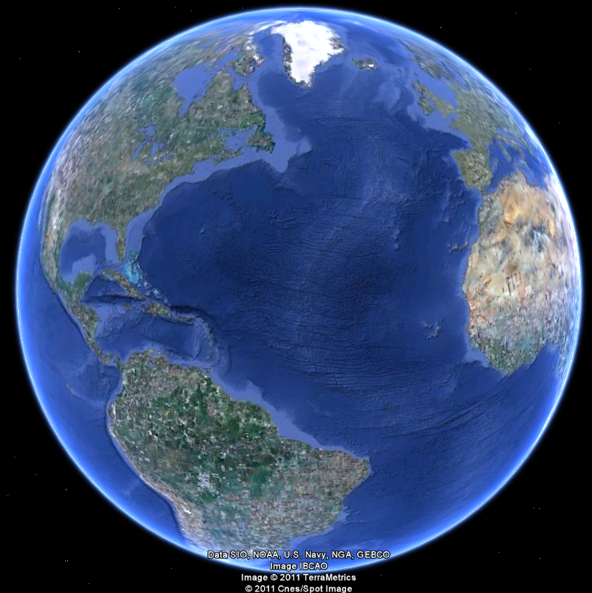
APEC 100 Sustainable Development
Climate Change and Sea Level Rise

Slide 2
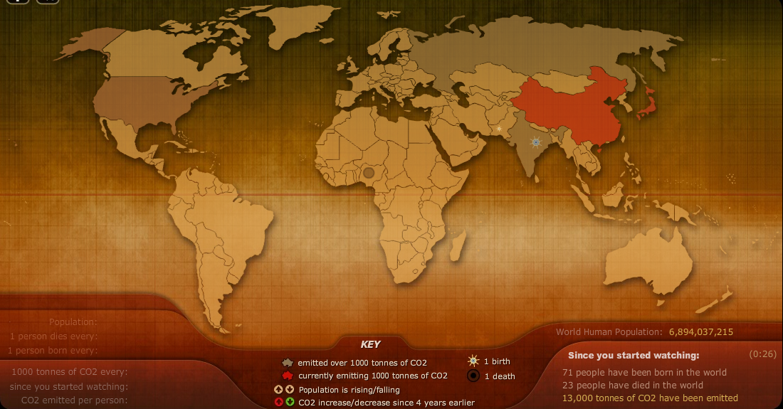
Global Population & CO₂ Emissions
www.breathingearth.net

Slide 3
Adapting to Climate Change in Delaware: Slides provided by Susan Love, DNREC Delaware Coastal Programs
Notes:
Welcome! Thank you for coming, we are very glad you have taken the time to be here tonight and look forward to sharing our work with you.
Today, we are presenting OPTIONS that may help the State prepare for sea level rise. We are seeking your feedback on these options and other ideas you may have.

Slide 4
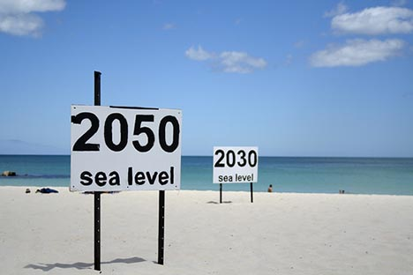
Basically, Sea Level Rise is…
Increase in average tide height over time as a result of:
Thermal Expansion
Melting of glaciers & ice caps
Influenced locally by subsidence

Slide 5
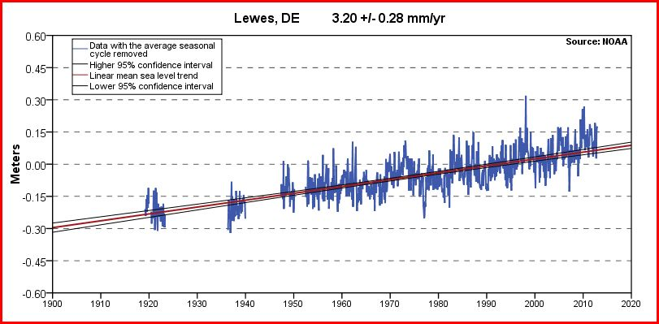
Annual Rate of Sea Level Rise
Average annual rate in DE = 3.35 mm/yr
(13 Inches/100 years)
Global rate = 1.7 mm/yr
Notes:
This graph shows tide gauge data collected at Lewes Delaware since the 1920s. This gauge shows that the rate of sea level rise in Lewes is 3.2 millimeters per year, or about 13 inches over 100 years. Averaged with the Reedy Point Gauge, Delaware’s average rate is 3.35 millimeters per year. Other gauges in the region show similar trends, from 3-4 millimeters per year. The global average rate is 1.7 millimeters per year. As you can see, Delaware’s rate is roughly twice that of the global average. This is due to the fact that Delaware is “subsiding” or sinking. More information about this is available at the poster displays.

Slide 6

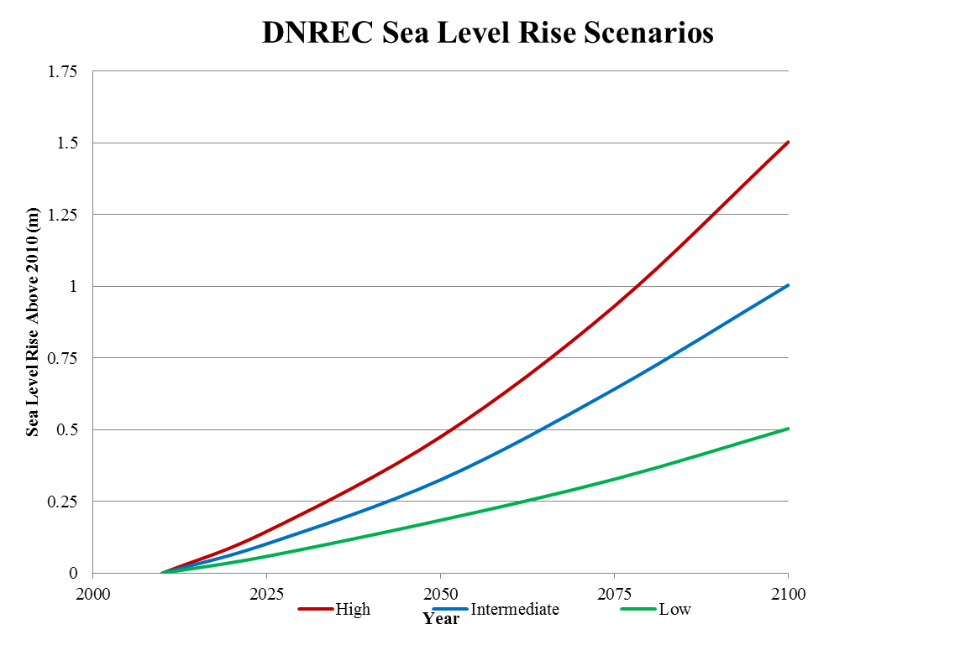
Rates of SLR are very likely to accelerate in the future
Notes:
The vulnerability assessment is based upon 3 future scenarios for sea level rise – 0.5m (1.6 ft), 1.0 meter (3.2 ft) and 1.5 meter (4.9 ft)
These scenarios are based upon national and international projections for future climate change and were agreed upon by a group of technical experts put together by DNREC.
A white paper is available online if you want more info, and also described in the vulnerability assessment.

Slide 7
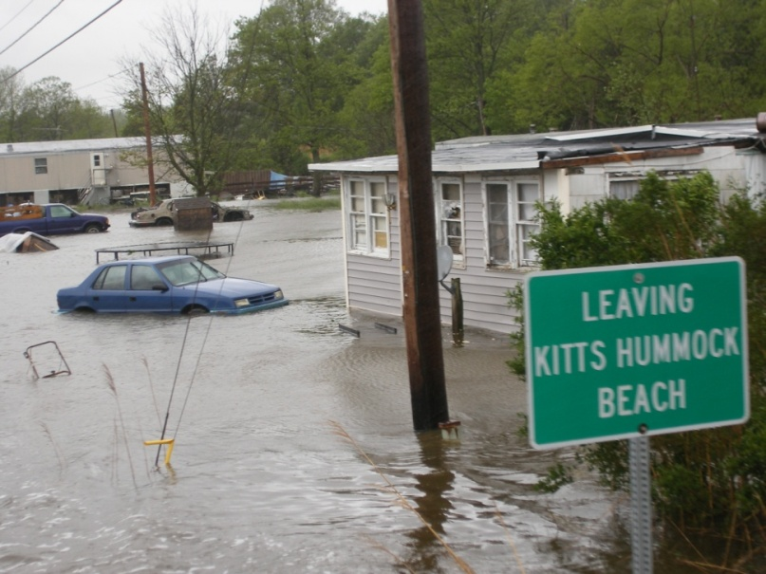
Potential Impacts of Sea Level Rise
Increased extent of periodic flooding
Permanent inundation of coastal areas
Saltwater Intrusion
Economic & Social Impacts
Notes:
These future scenarios are important because potential impacts of sea level rise, if no action is taken to prepare or adapt, could significantly impact our economy, environment and communities. Impacts include increased extent of periodic flooding that occurs during storm events, permanent inundation of low-lying coastal areas and saltwater intrusion into surface waters and ground water. All of these have secondary economic, social and environmental impacts ranging from reduced crop yields, to damaged homes and infrastructure and loss of wildlife habitat and outdoor recreational opportunities.

Slide 8
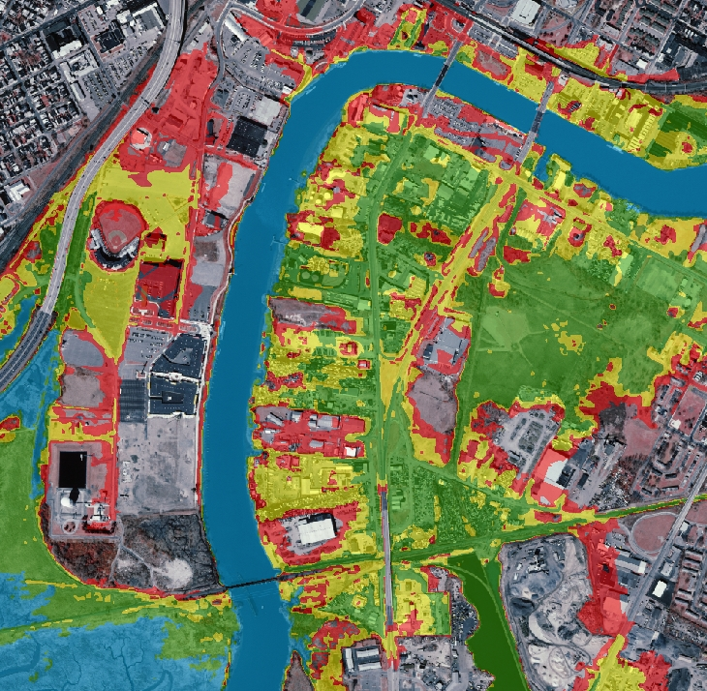
SLR will affect all of Delaware
In Urban Areas in Northern DE:
Transportation Networks
Neighborhoods
Economic Development Zones
Public Safety Facilities
Sewer Lines/Capacity
South Wilmington and Surrounding Areas with 0.5, 1.0 and 1.5 meters of SLR to 2100
Notes:
I like to make sure that everyone understands that SLR is not an issue that affects only those with beach homes. This is a statewide, regional and national and worldwide issue. In South Wilmington, you will see significant impacts without action.

Slide 9
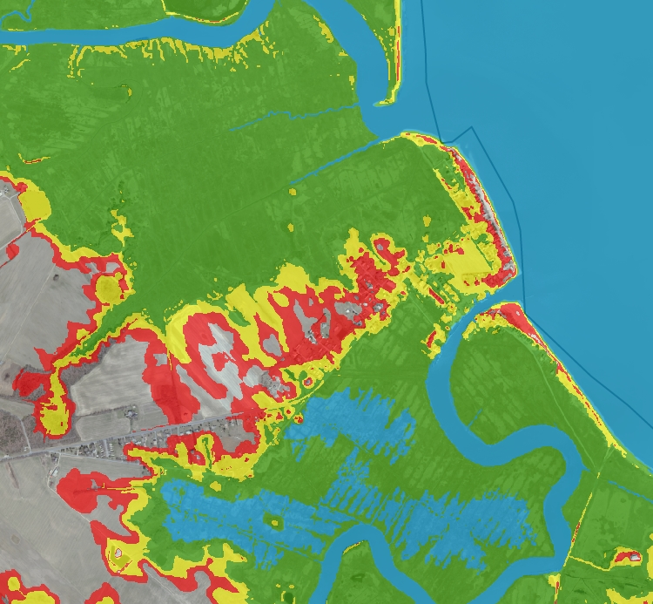
Sea Level Rise will affect all of Delaware
At risk in Coastal Kent County:
Commercial/Recreational Fishing Docks
Residences
Habitat
Wetlands
Shorebirds
Horseshoe Crabs
Way of Life
Bowers Beach and Surrounding Areas with 0.5, 1.0 and 1.5 meters of SLR to 2100
Notes:
In Coastal Kent County, much of the impact will be natural resources rather than homes and industry.
While the pictures here show potential inundation, all residents inland could also be affected from transportation issues, lack of access to recreation, increased taxes for flood impacts etc.

Slide 10
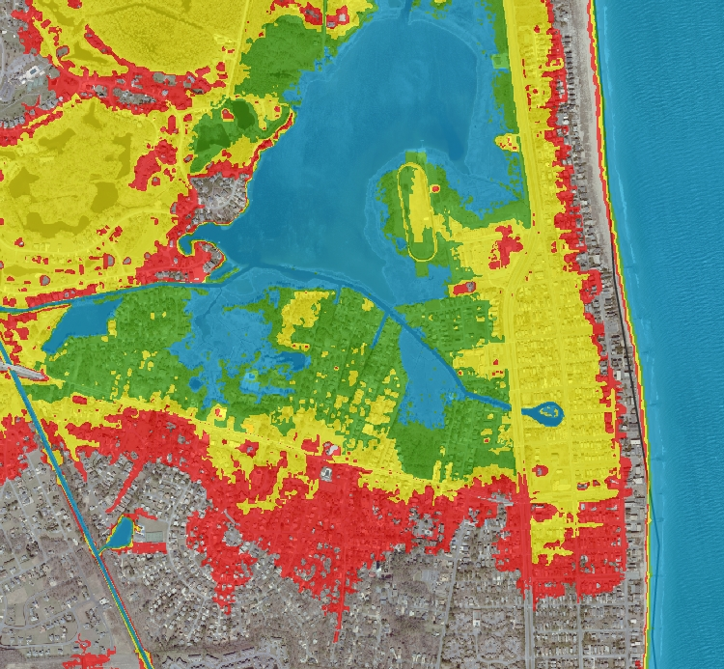
Sea Level Rise will affect all of Delaware
At risk in the Sussex Coastal Area:
Homeowners
Bayfront and Oceanfront
Tidal Wetlands and riparian areas
Habitat
Flood Attenuation
Transportation Networks
DE National Guard
Bethany Beach and Surrounding Areas with 0.5, 1.0 and 1.5 meters of SLR to 2100
Notes:
Beach communities are also at risk, but so are back bay communities. You can see that according to this map, many beach-front homeowners may not be flooded—however, this assumes that state and federal governments continue to replenish beaches. While these homes may not be flooded, issues with transportation and wastewater may render a home uninhabitable.

Slide 11
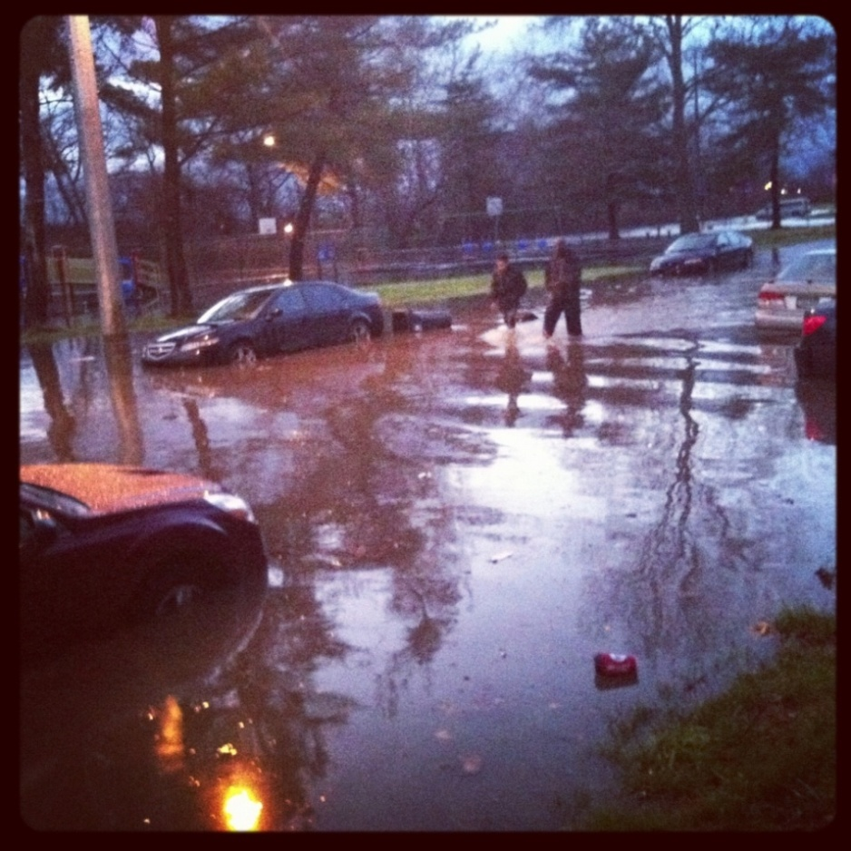
Today’s storm is tomorrow’s high tide
Ash Wednesday ’62
Lewes, 4.6ft over MHHW
Mothers Day ’08
Lewes, 3.24ft over MHHW
Veterans Day ’09
Lewes 3.23ft over MHHW
Sandy, 2012
Reedy Point—3.26ft over MHHW
Lewes—4.6ft over MHHW
Dec 21, 2012
Reedy Point—3.36ft over MHHW
DNREC SLR Scenarios within range of current storm surge
‘62 Storm, Lewes – 4.5 ft
‘08 Mother’s Day Storm, Bowers – 4 ft
‘09 Veteran’s Day Storm, Lewes – 3 ft
Measures to adapt to SLR long term will help prepare for temporary effects of storm surge
And vice versa
Bradford Street, Wilmington—Dec 21, 2012
Notes:
It is important to note that Delaware is routinely seeing flooding of 3.2 feet above MHWW now, and these large flooding events are not limited to nor’easters or hurricanes. On December 21 of last year, we had a storm anomaly that caused tide levels in New Castle to exceed the tide levels during Sandy. This picture shows Bradford Street in Wilmington, Delaware.

Slide 12
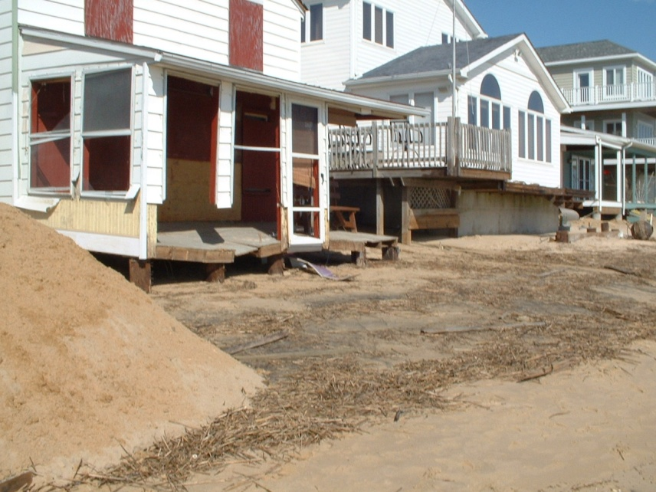
Bowers Beach, then and now
2008
1962
http://coastal-flood.udel.edu/

Slide 13
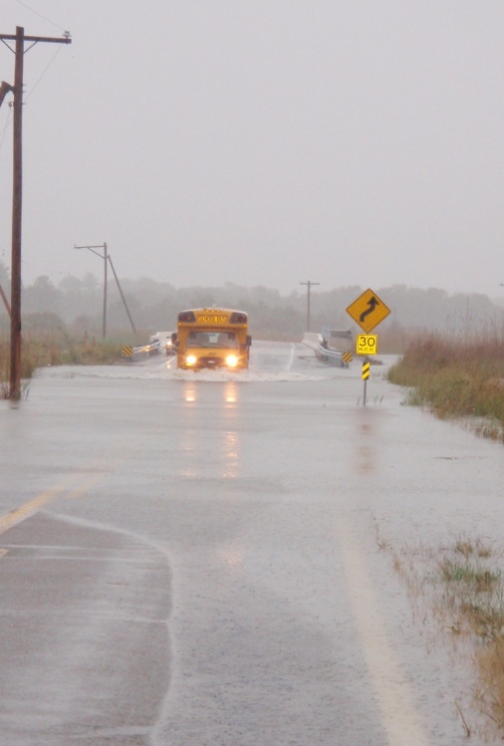
Planning for Sea Level Rise
Sea levels are rising
Annual rate of rise likely to increase
Preparing for long-term effects of sea level rise may also help minimize short term impacts from storms
Land use & public works decisions have long life-span
Wise use of public funds and reduction of future risk
Odessa, 2009
Notes:
Delaware is planning for between 1.6 and 4.9 feet of sea level rise by the year 2100. You may ask yourself “why are you planning for sea level rise now if the effects are so far into the future?” The current rate of sea level rise in Delaware is about 13 inches per 100 years. Climatologists believe that this rate will increase in coming decades. Land use decisions, public works decisions and habitat management decisions have long life spans; considering future sea levels in their design and placement is a wise use of public funds and reduces future risks to people and property. In addition, making better decisions now using future sea levels as a guide may also help minimize short term impacts from storms. Delaware is just one of more than a dozen coastal states that are investigating the potential impacts of sea level rise and developing plans to adjust to the changing coastline.

Slide 14
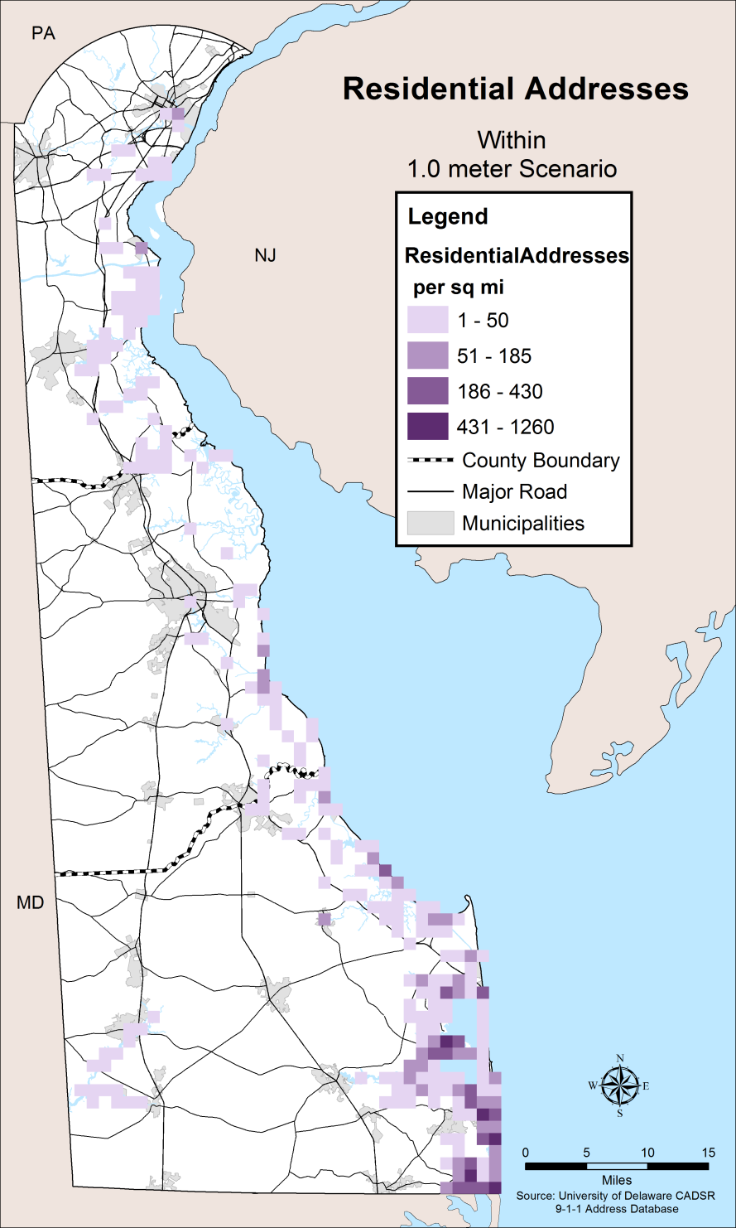
Residential
1%-5% of 346,000 addresses potentially inundated
Up to 32% of manufactured homes in Sussex
Up to 13% (15,000) homes in Sussex
Impacts
Flood damage, insurance costs, access, community
Varying ability to adapt
Primarily County level impact
Ranked as moderate
Notes:
I’d like to quickly highlight a few of the findings from the Vulnerability Assessment. If you would like to know more, CDs of the assessment are available, and it can be downloaded online at: http://de.gov/slrva
Over 17,000 homes could be inundated by sea level rise at the 1.5 meter scenario; these homes are primarily located in Sussex County, who would also see over 30% of its manufactured homes at risk.

Slide 15
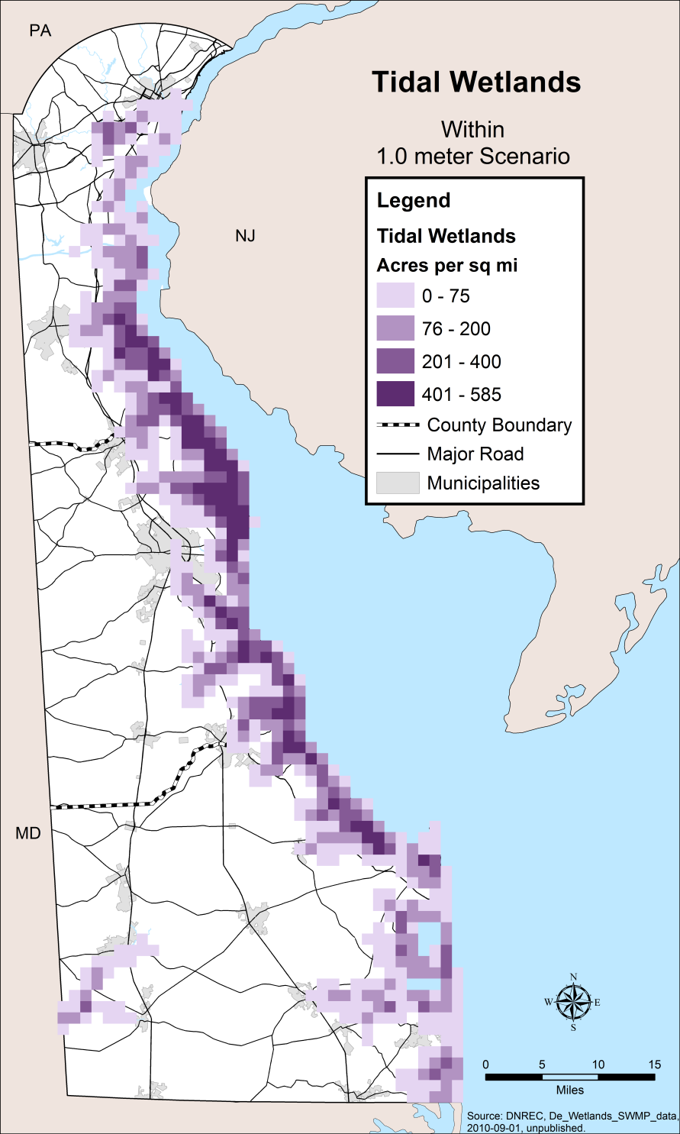
Tidal & Freshwater Tidal Wetlands
Tidal
97% to 99% of 73,000 acres potentially inundated
Freshwater Tidal
84% to 98% of 11,000 acres potentially inundated
Conversion to open water
Future salinity changes potential issue for tidal fresh
Ranked as high

Slide 16
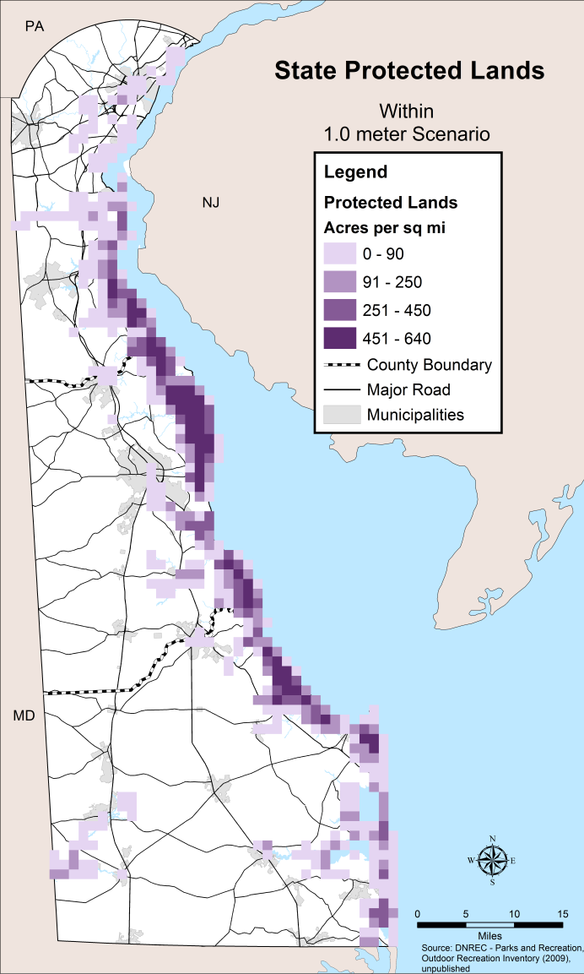
Protected Lands Statewide
37% to 44% statewide potentially inundated
Includes
State owned lands
federal refuges
municipal holdings
public and private conservation easements
Represent a variety of habitat types and outdoor recreation opportunities
Notes:
Protected lands represent a variety of lands including State owned properties such as wildlife areas, parks, state forests, boat ramps, natural areas, nature preserves, and historical sites; federally owned wildlife refuges (Bombay Hook and Primehook); municipal holdings such as municipal parks, open space, and recreational facilities; and public and private conservation easements.
State and federal governments, and non-profit agencies have spent considerable resources permanently protecting these areas, which are important for wildlife hemispherically. If these natural areas cannot adjust to keep pace with sea level rise, they may be permanently lost.

Slide 17
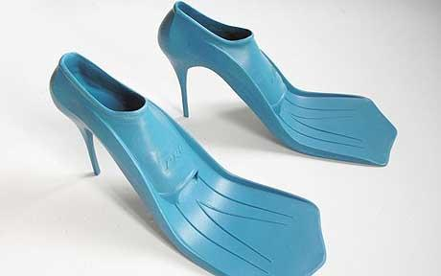
A Range of Adaptation Responses
Protect
Accommodate
Retreat
Avoid
These fashionable high-heeled flippers are an Accommodation strategy for sea level rise
Notes:
“Adaptation” simply means the way that we choose to respond. There are four primary ways to respond:
Protect = Building Protective Structures to hold back water
Accommodate = changing behaviors and lifestyles to deal with encroaching water
Retreat = Moving structures out of flooded areas and/or letting nature take its course
Avoid = not placing new structures in at risk areas

Slide 18
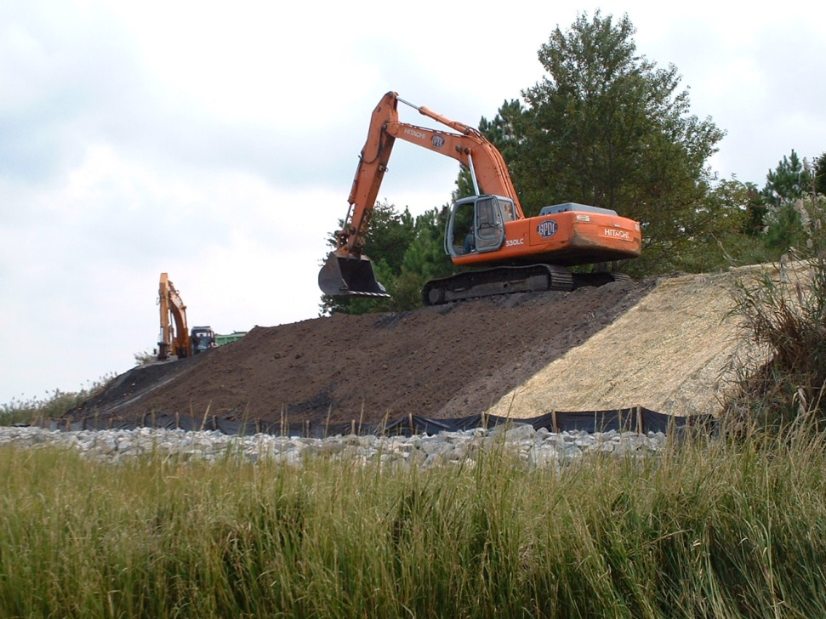
Protect
Building structures designed to keep water away. This includes sea walls, bulkheads, dikes, living shorelines and beach replenishment.
Burtons Island
Notes:
A Strategy of Protect means that you would choose to build structures that would hold the water back. This would include Dikes, sea walls, bulkheads and beach replenishment projects. Many places along our shoreline have already chosen to adapt in this way. We have a long-standing program of beach replenishment, in partnership with the Federal government, that has by and large, kept our ocean and bay beaches in place, providing recreation and storm protection. We also have a series of dikes in the northern part of the state that have kept water out of New Castle and other locations – these dikes are now undergoing serious repair. This is a primary issue with the protection strategy—maintenance of the structure, particularly after storm damage.

Slide 19
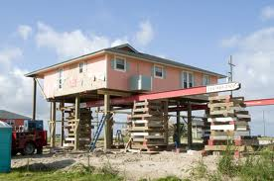
Accommodate
Reducing flood damage while living with its effects . This includes raising homes and roads, early evacuations and living by the tides.
Notes:
An accommodation strategy seeks to reduce flood damages without building structures that may fail in the future or require repair. This strategy could be used together with other strategies. Accommodation includes those high heeled flippers I showed you earlier, plus raising homes above the flood elevation, flood-proofing structures with flood doors and windows. It also includes paying attention to storms – evacuating early and maybe avoiding certain roads at high tide.

Slide 20
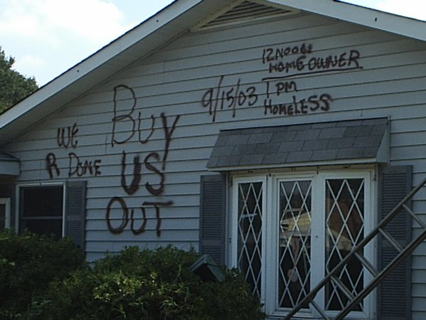
Planned Retreat
Removing permanent structures from vulnerable areas in a planned and predictable way and allowing the shoreline to change naturally.
Glenville, 2003
Notes:
A planned retreat strategy would remove structures from at-risk areas and allow the shoreline to move naturally inland. Retreat is the most likely strategy for many of our natural areas and wetlands that will likely move inland over time. Retreat strategies for communities is a much more difficult topic, but it has recently been done in Delaware.
There is another retreat strategy: UNPLANNED retreat. Unplanned retreat could occur as a result of putting off decision-making; this is why we are talking about Adaptation to SLR now. By putting off difficult or costly decisions, we could inadvertently be choosing to retreat.
A retreat strategy was implemented in community of Glenville in New Castle County, not because of sea level rise, but because of frequent flooding caused by development upstream. This project had great emotional and economic cost. Folks, this is not an easy topic to discuss but one that is worth the conversation.

Slide 21
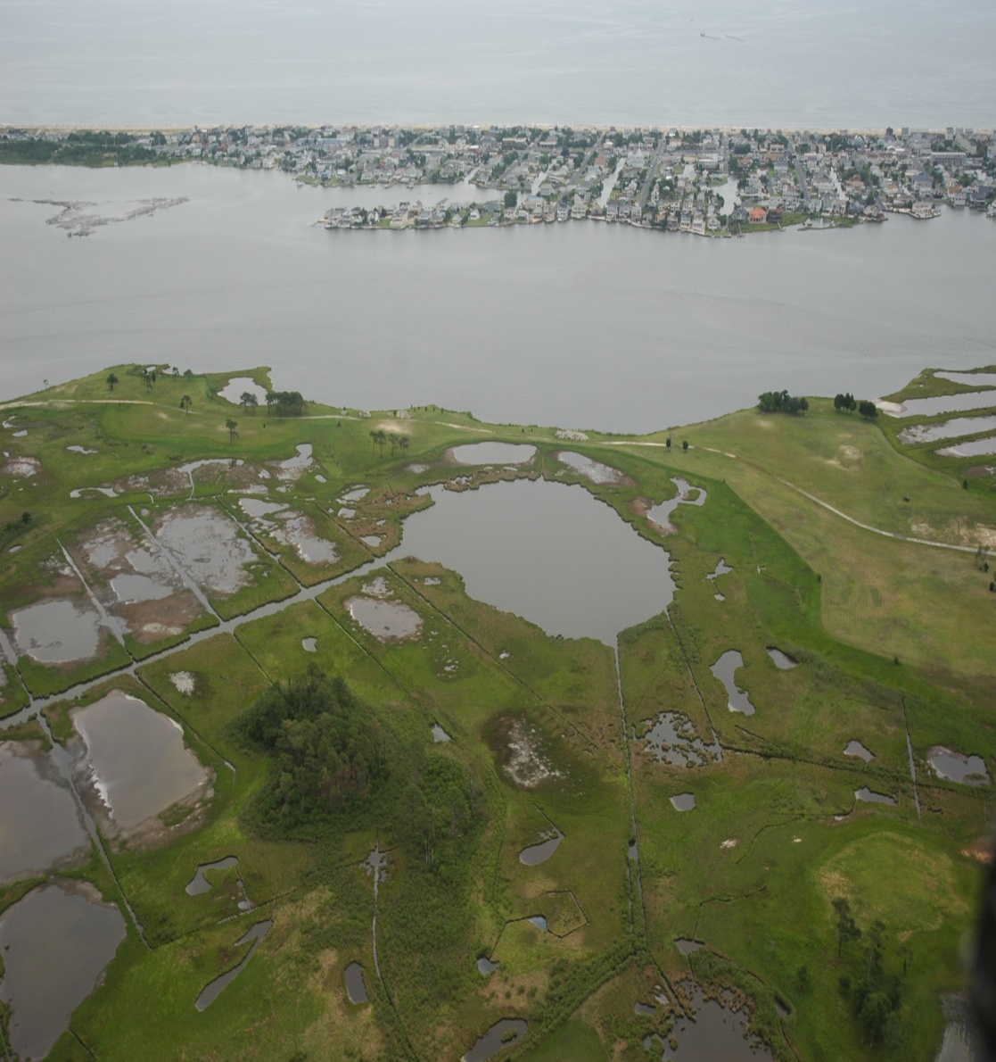
Avoid
Identifying at-risk areas and directing new development to less vulnerable areas through voluntary measures and improved codes.
Lighthouse Cove, Fenwick Island DE
Notes:
An Avoidance Adaptation Strategy is one where we identify areas that will be affected by sea level rise in the future and direct growth away from those areas, minimizing future risks. Avoidance can be accomplished through land use ordinances and development codes, but also through land preservation and conservation easements.

Slide 22
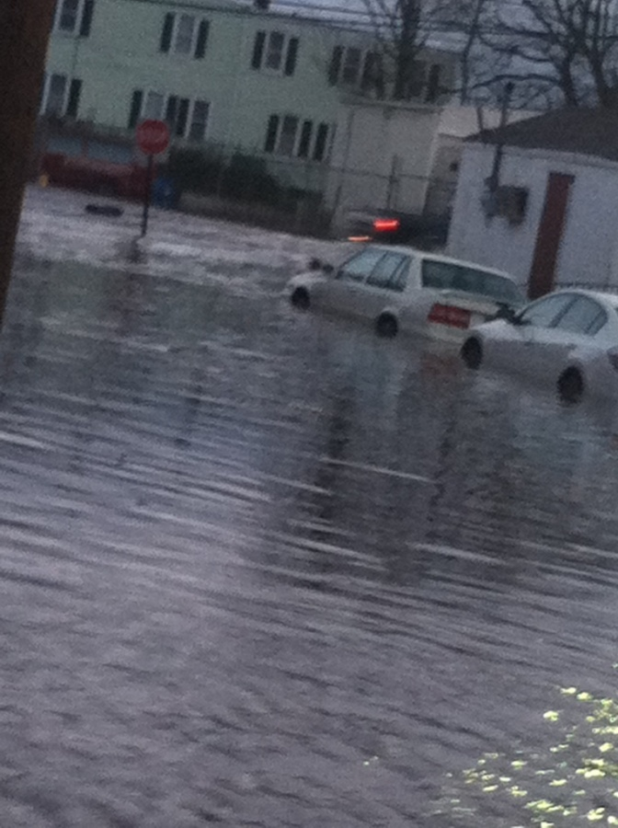
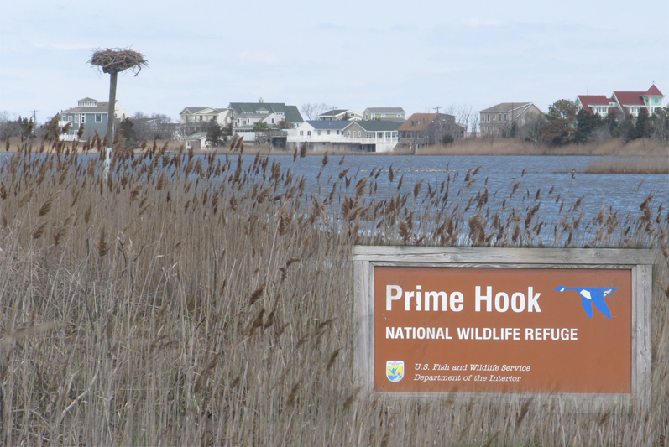
A tale of 2 cities
Prime Hook Beach
Southbridge

Slide 23
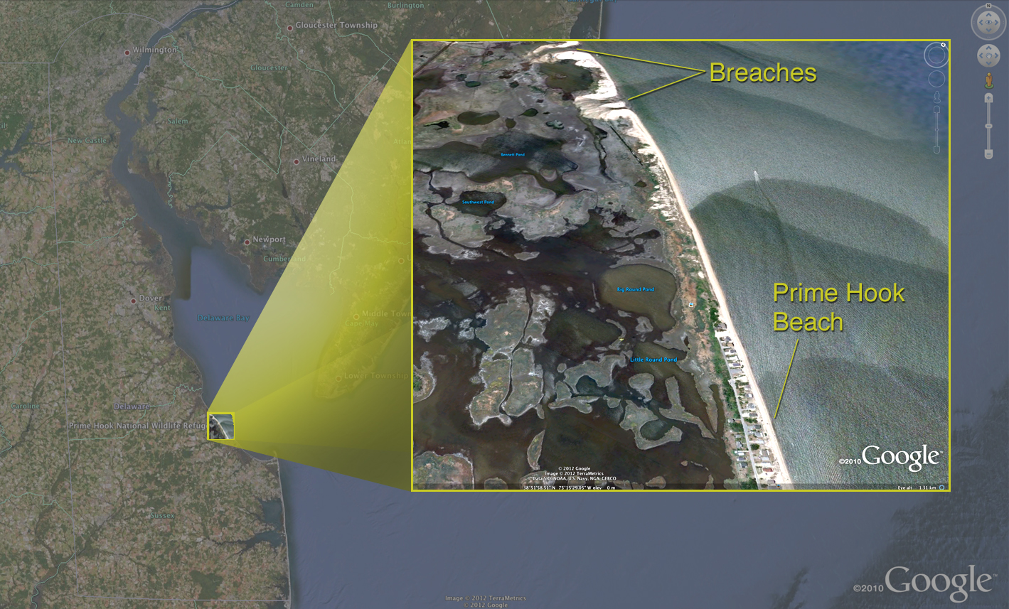
Primehook Beach

Slide 24
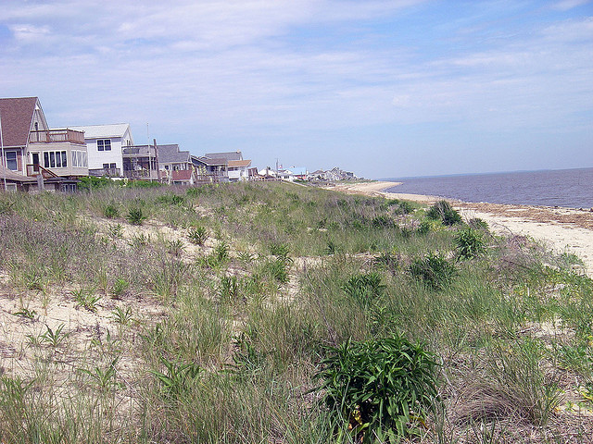
A charming beach community

Slide 25
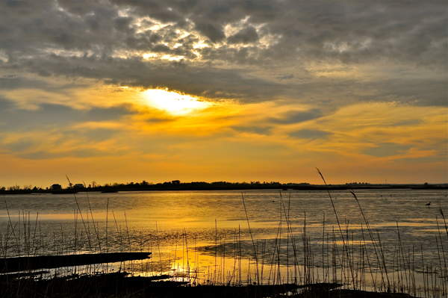
A natural paradise

Slide 26
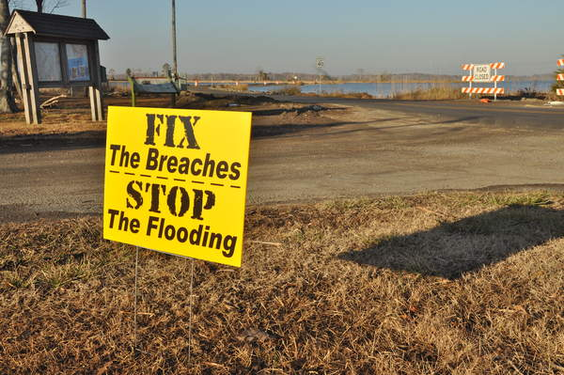
A looming disaster

Slide 27
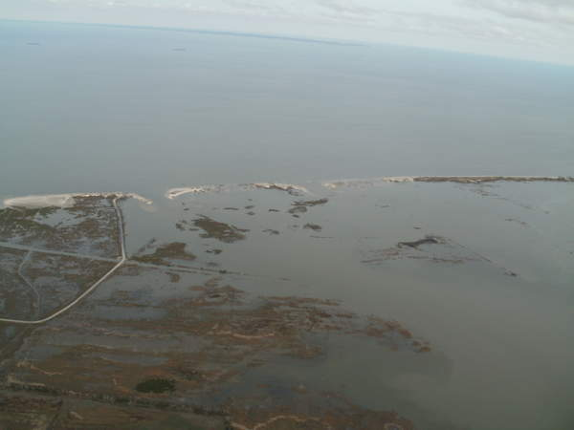
Breaches in barrier dune system

Slide 28
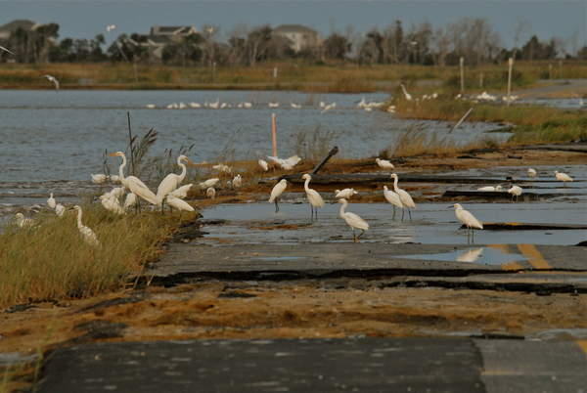

Slide 29
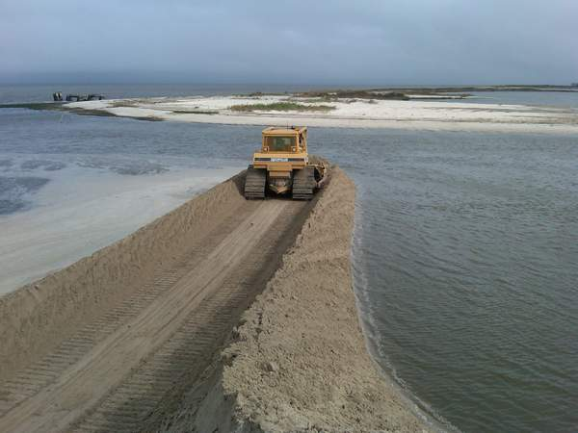
Choices
Fix Breach and keep impoundment
Fix Breach and create tidal wetland (20M)
Beach Replenishment

Slide 30
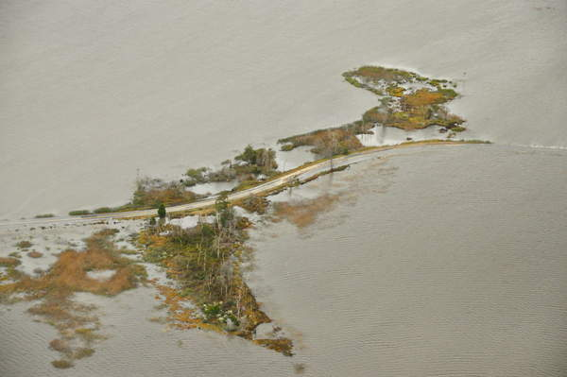
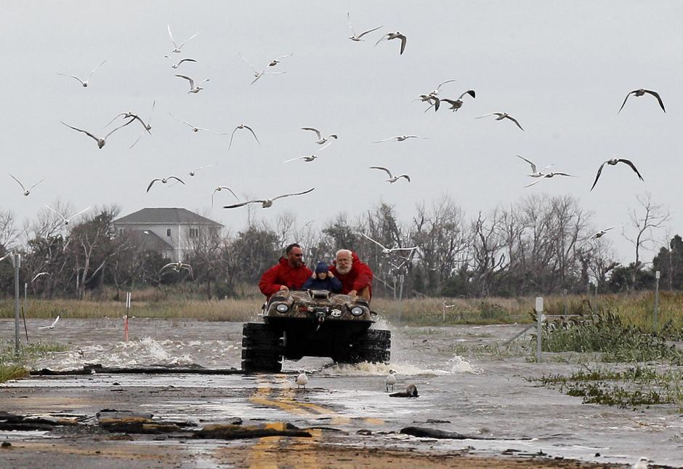
But then what?
Spend 50M to build a “causeway?”
Spend 20M for sewer and water?
Raise houses out of floodplain?
End up retreating anyway because of SLR?

Slide 31
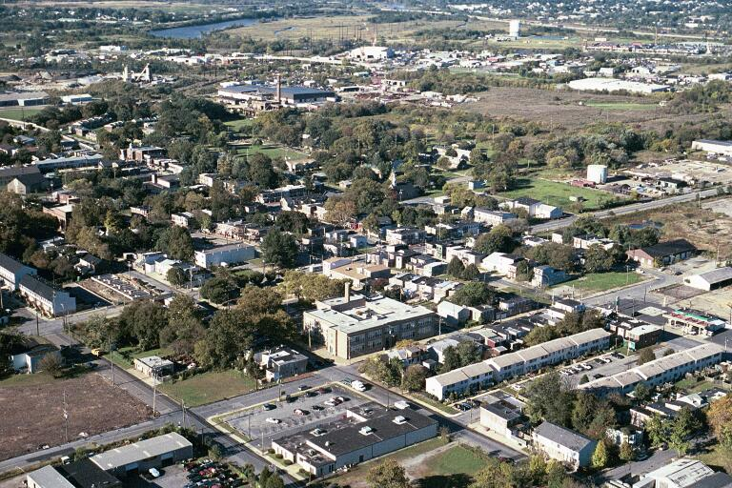
Southbridge

Slide 32
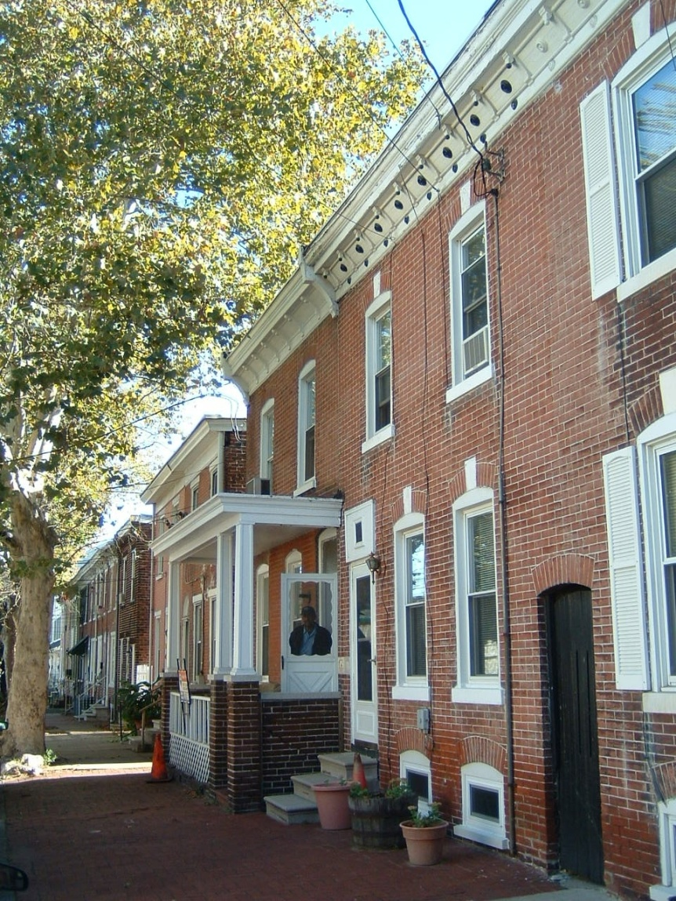
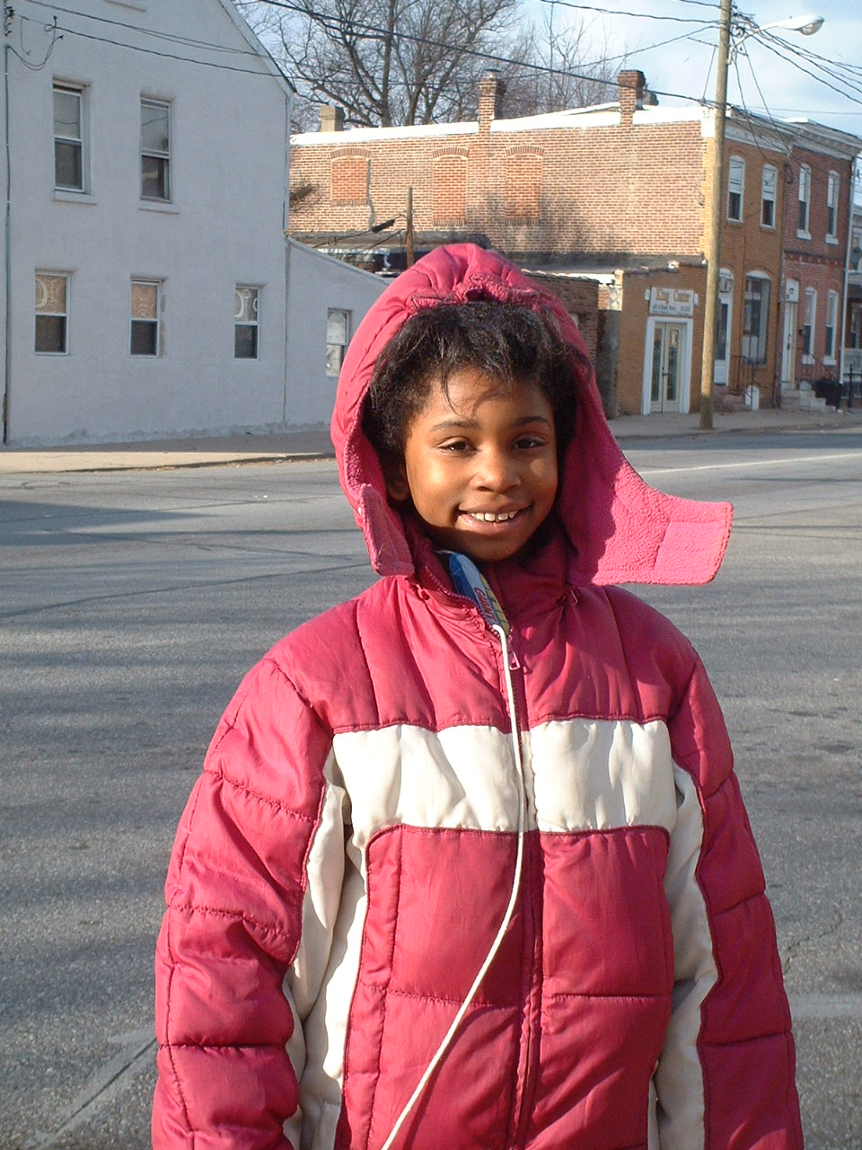
Historic Urban Community

Slide 33
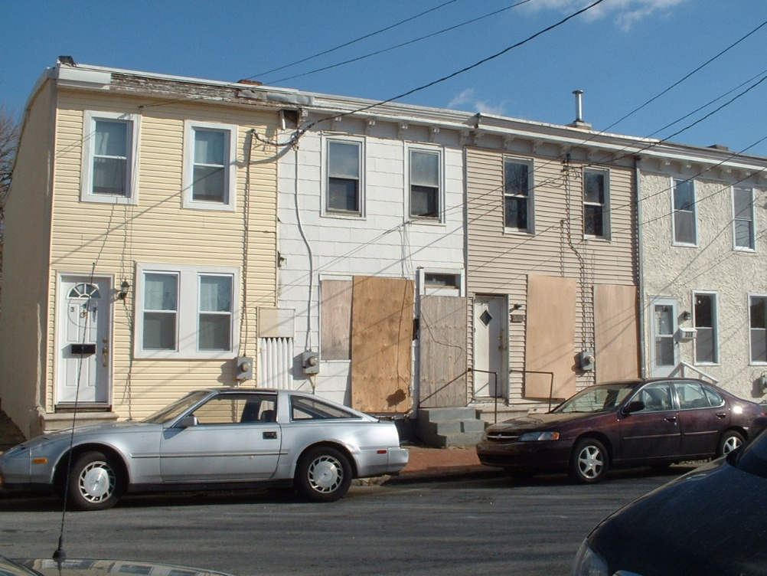
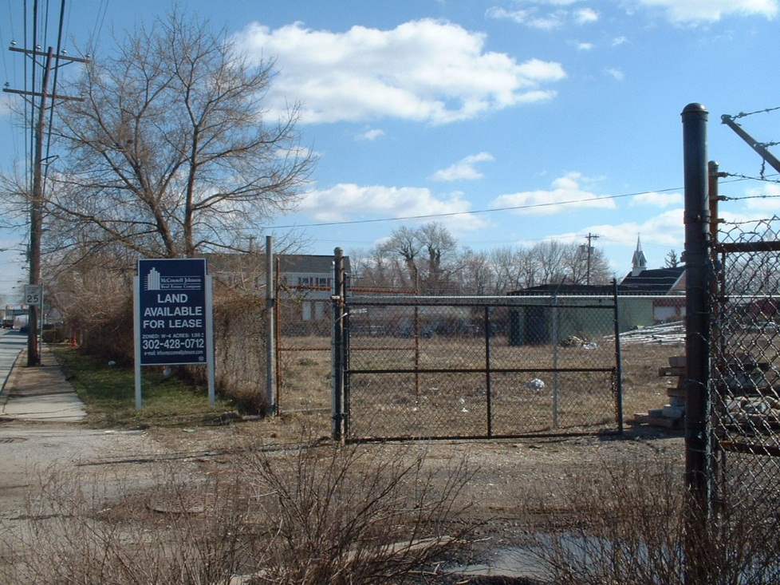
With Environmental Justice Issues

Slide 34
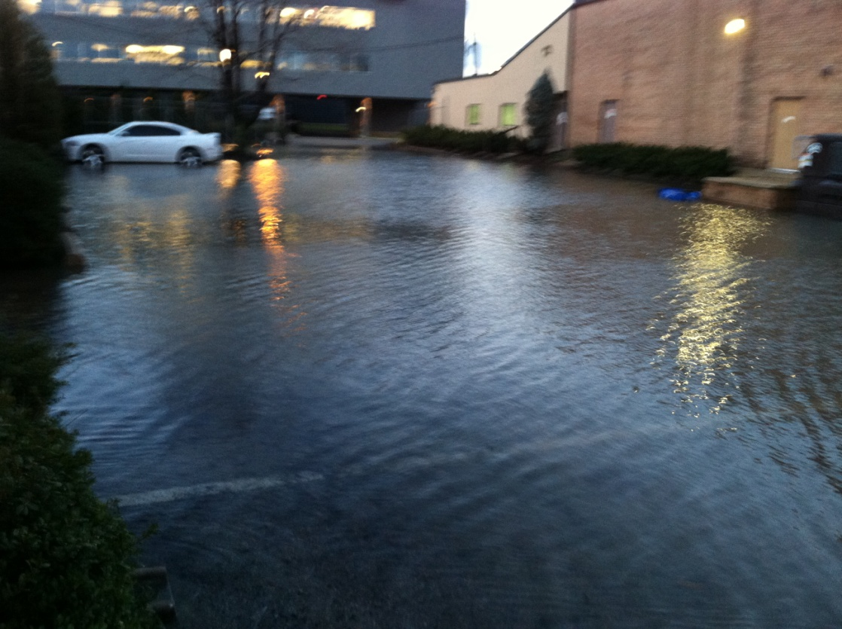
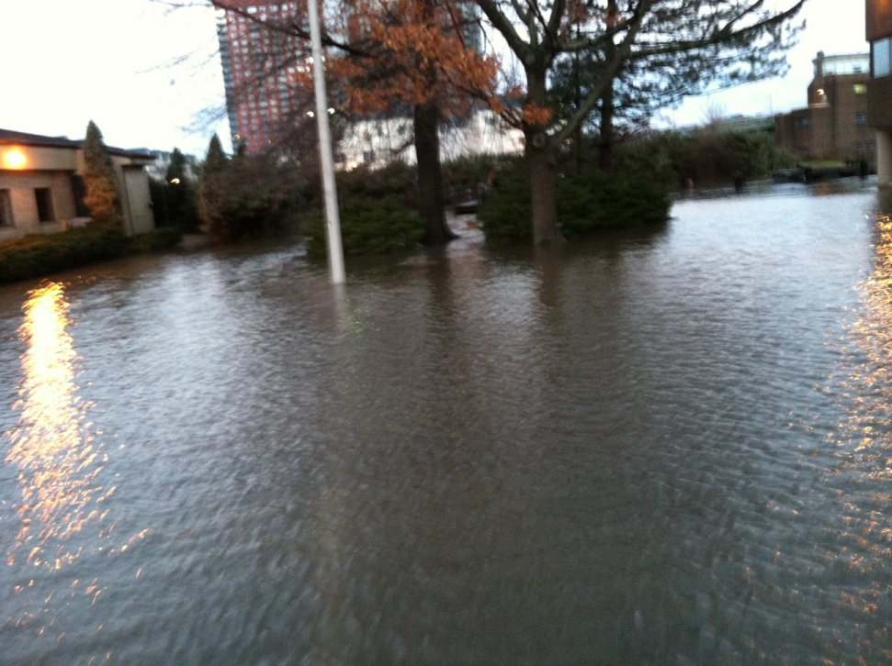
And significant flooding issues

Slide 35
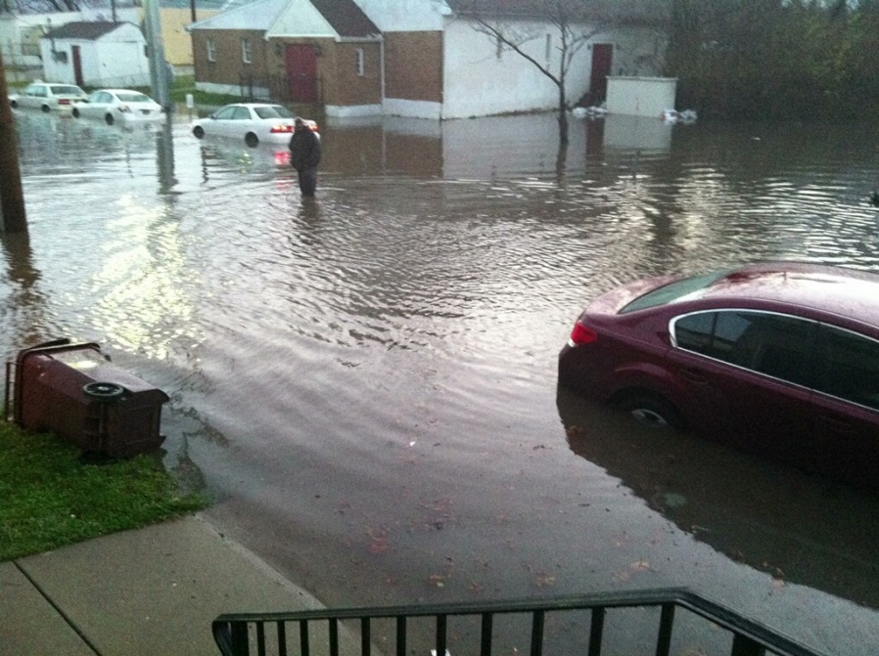
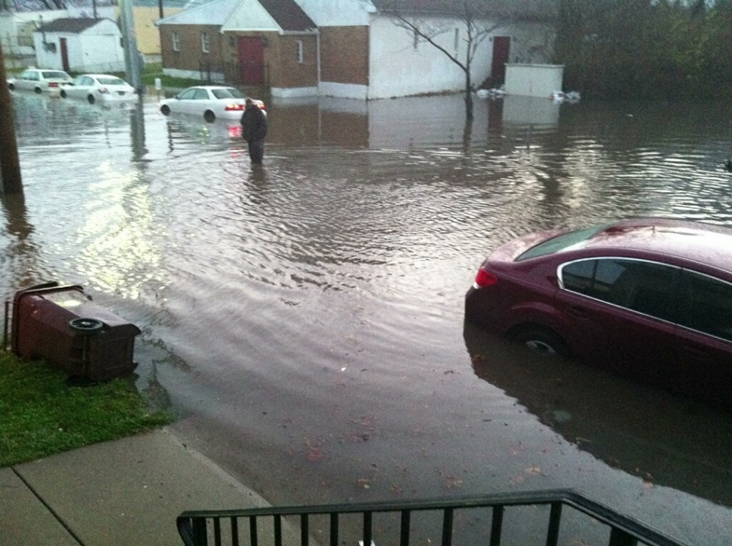
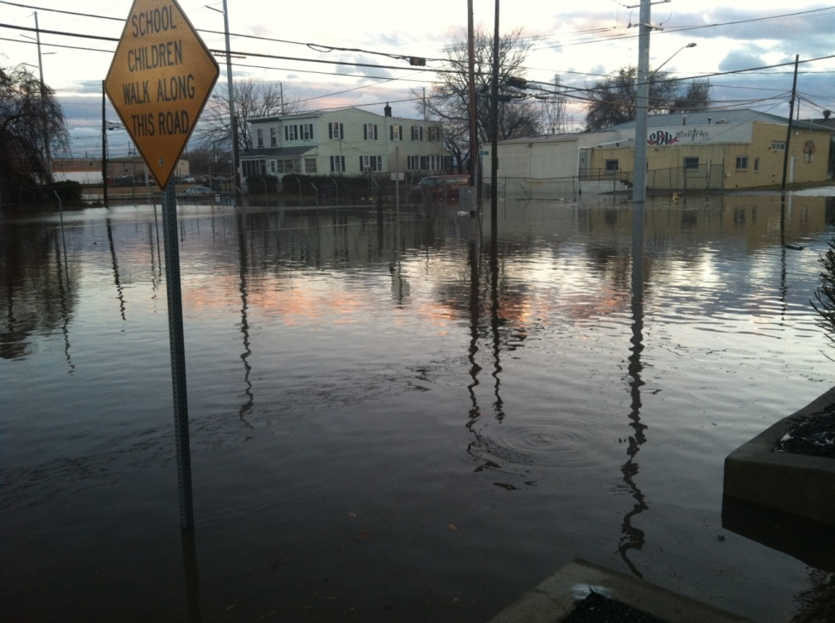
Flooding

Slide 36
Choices
Green Infrastructure Projects (10M)
Fix Combined Sewer (4M)
Elevate homes (30k each)
Build Seawall and pumps?
Retreat?

